Slide 1
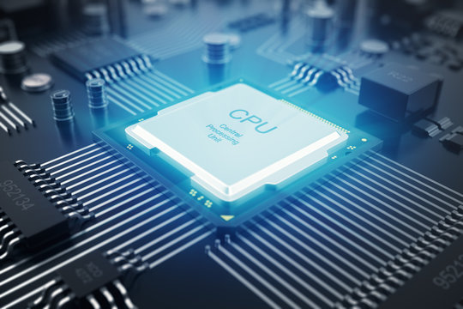
CPU(Central processing unit)

Slide 2
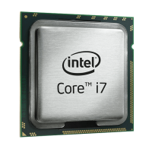

Introduction to CPU
CPU stands for central processing unit. It is a tiny, powerful chip located on the motherboard.
The main function of a CPU is to follow instruction from programs and apps.
It is also called the BRAIN of the computer. It does the thinking and tells the other parts of the computer what to do.

Slide 3
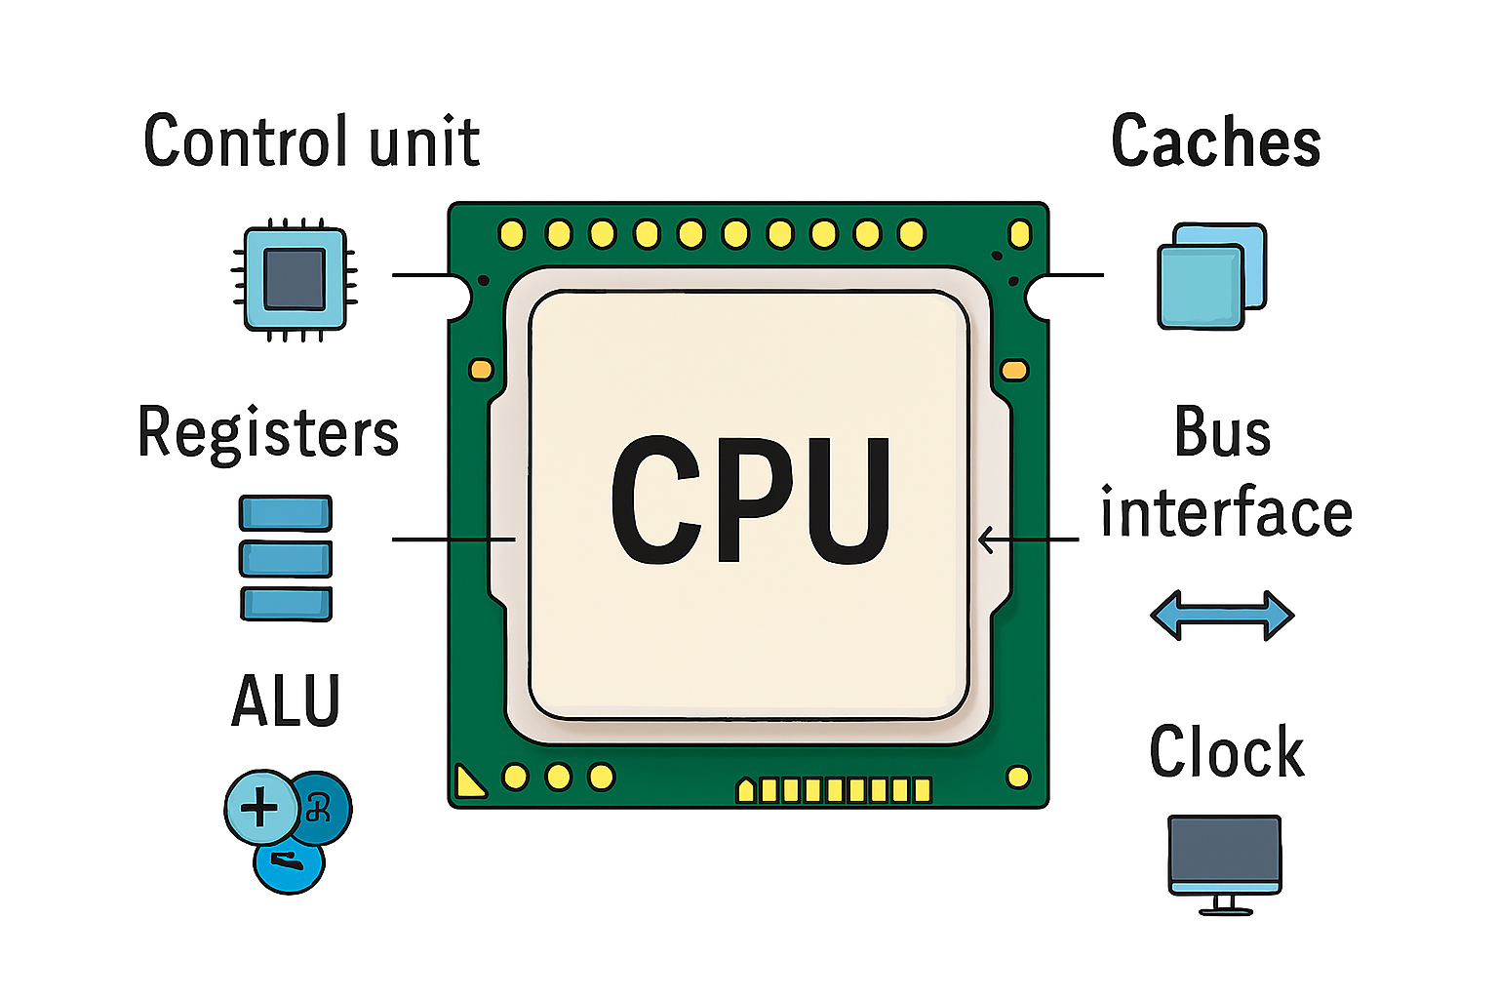
The major internal components of a CPU
ALU(Arithmetic logic unit): It performs arithmetic and logical operations.
CU(Control Unit): It is responsible for directing and coordinating all operations.
Registers: It is the temporary storage for the instructions and data.
Cache: It store frequently accessed data for faster processing.
Bus: It set of find pathways that transfer data and signals.
Clock: It synchronizes all CPU operations.

Slide 4
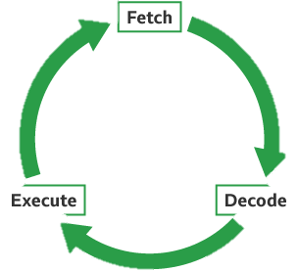
The Fetch-Decode-Execute Cycle
Fetch: The Program Counter (PC) register holds the address of the next instruction. This instruction is fetched from memory/cache into the Instruction Register (IR).
Decode: The Control Unit decodes the instruction in the IR.
Execute: The CU commands the ALU, FPU, or other unit to perform the operation. Data is moved from registers or cache as needed.
Store(optional): The result is stored back in a register or memory.

Slide 5
CPU Performance Factor
Clock Speed (GHz): Determines how fast instructions are processed.
Cores: More cores allow better multitasking.
Threads: Virtual cores that improve parallelism.
Cache Levels (L1, L2, L3): Faster access to data.
Instruction Set Architecture (ISA): Defines how instructions
are processed (e.g., x86, ARM).

Slide 6
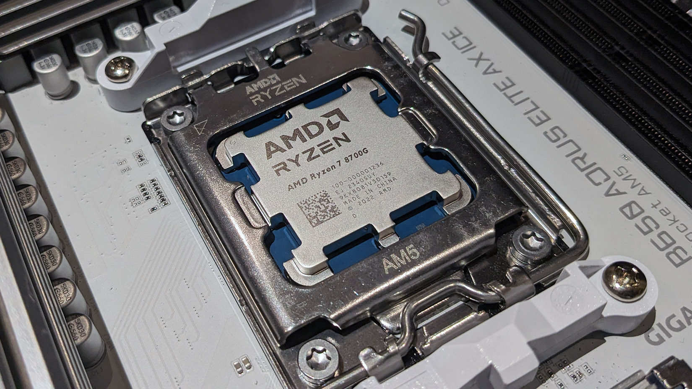
Types of CPUs
Some of the types of CPUs are :-
Single-core : This CPU have only one processing unit . Eg, intel Pentium 4, AMD Athlon xp
Multi-core :- This CPU have multiple unit for parallel tasks. Eg, AMD Ryzen 9.
Mobile CPUs:- This CPU is optimized for power efficiency. Eg, Apple M2
Server CPUs:- This CPU is used for high performance in data center. Eg, intel Xeon.

Slide 7
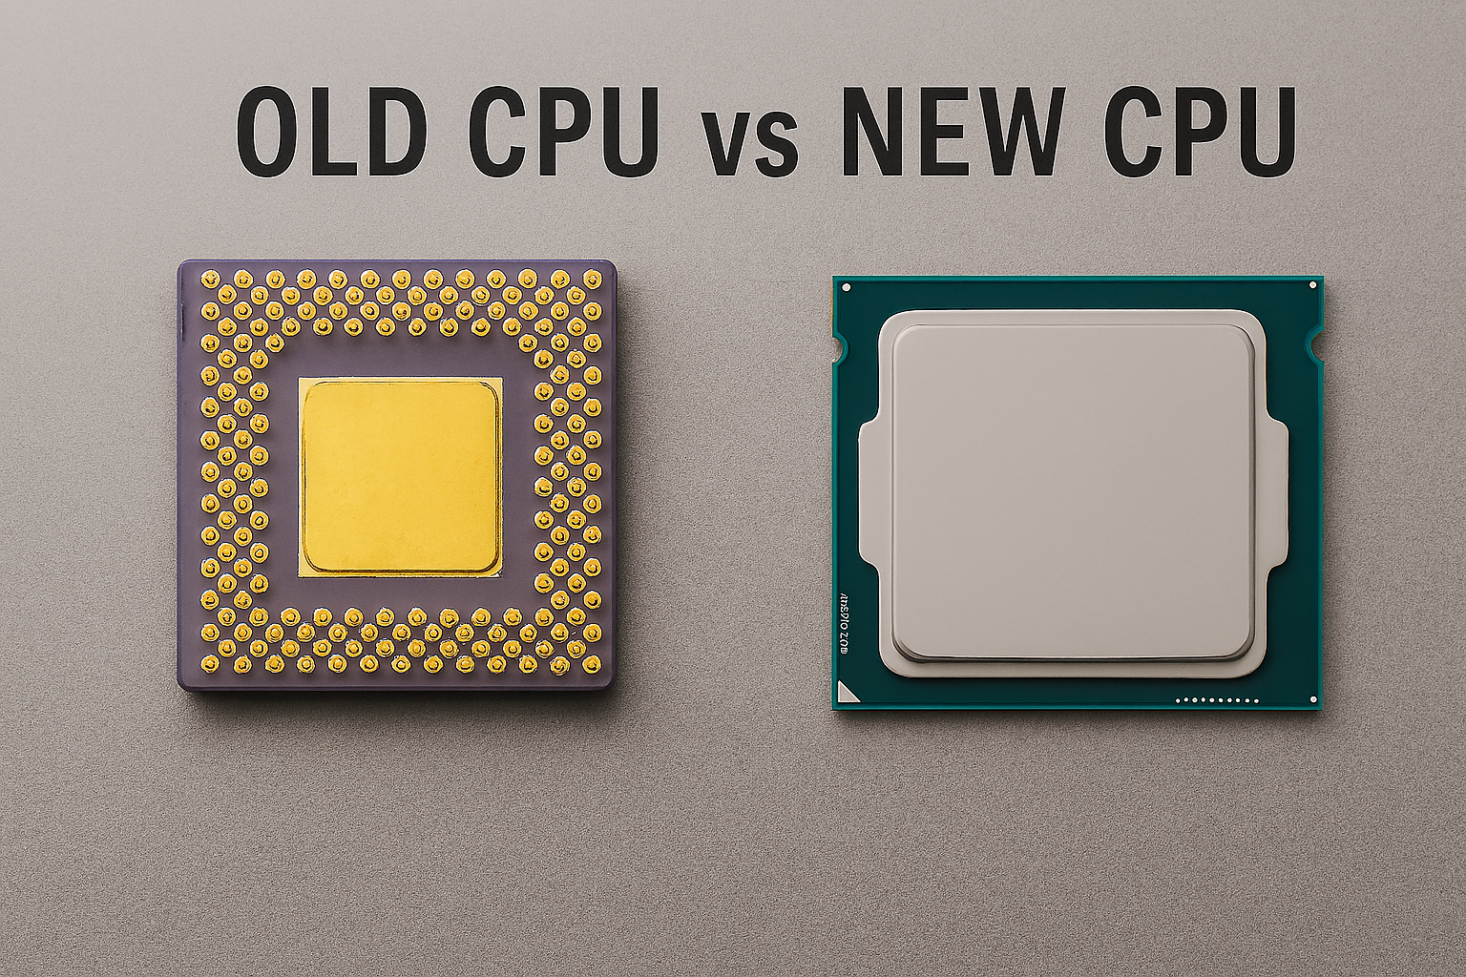
Evolution of CPU
1971: Intel 4004 – first commercial microprocessor.
1980s–90s: Rise of 16-bit and 32-bit processors.
2000s: Multi-core revolution.
2020s: AI-optimized and ARM-based CPUs. Include timeline graphic.

Slide 8
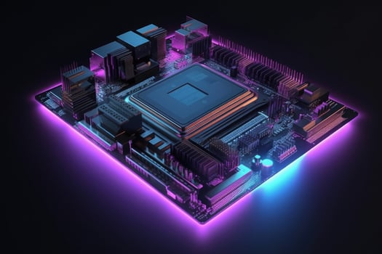
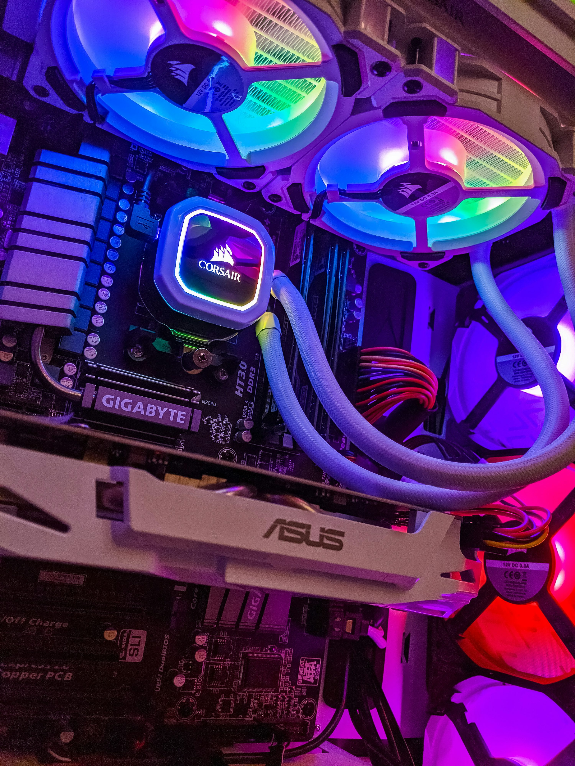
Application use of CPUs
Gaming: Real-time processing and physics.
AI & ML: Training models and inference.
Scientific Computing: Simulations and data analysis. Etc.

Slide 9
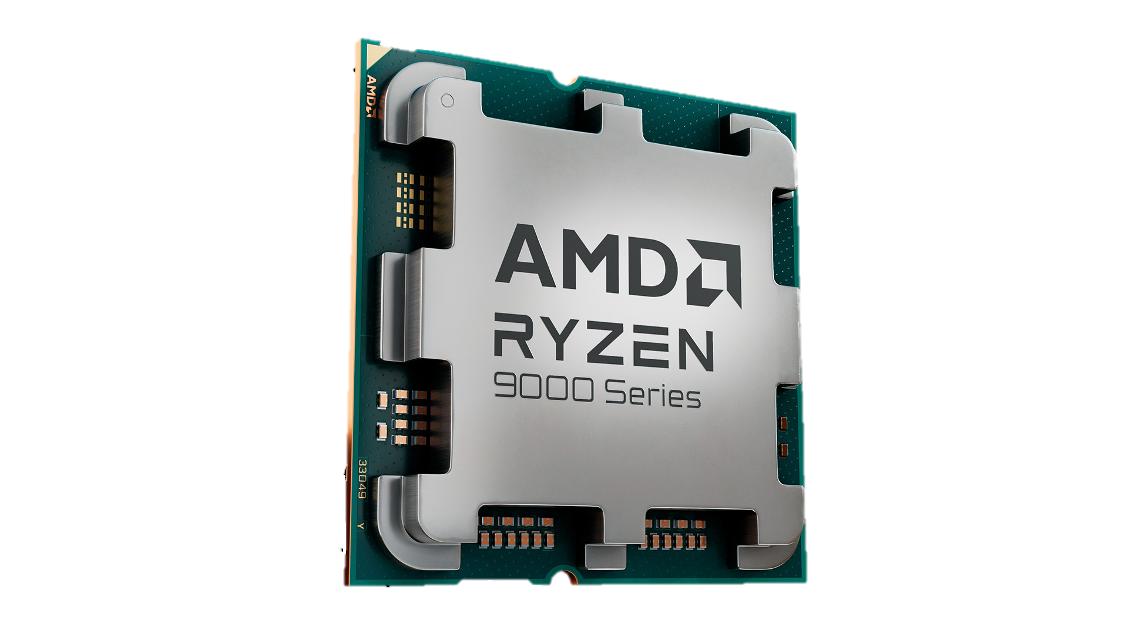
Model of Processors
Model | Brand | Use case
AMD Ryzen 5 7530U | AMD | Mid-range ultrabooks
Intel Core i7-1260P | Intel | Thin-and-light performance laptops
Intel Core i7-13700H | Intel | High-performance laptops
Ryzen 9 9950X3D | AMD | Ultimate gaming & multitasking

Slide 10
Summary
CPUs are essential for all computing tasks.
Key components: ALU, CU, Registers, Cache.
Fetch , Decode, Execute.
Performance depends on speed, cores, and architecture.
CPUs continue to evolve with AI and mobile computing.
Application area of CPUs.
Evolution.
Model of processor Intel & AMD.

Slide 11

Thank You

